Slide 1
DevSecOps w teorii i praktyce
Konrad Sagała
Cloud Security Architect, Alior Bank

Slide 2


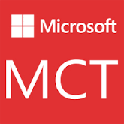
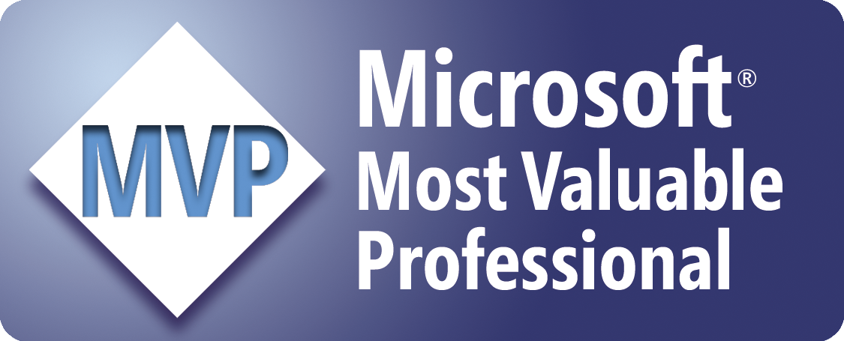
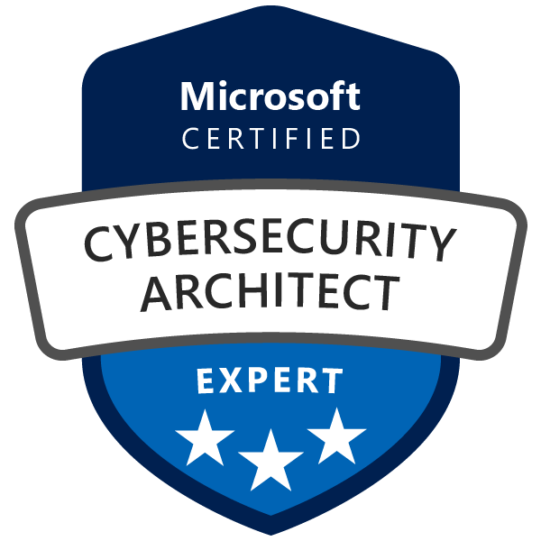
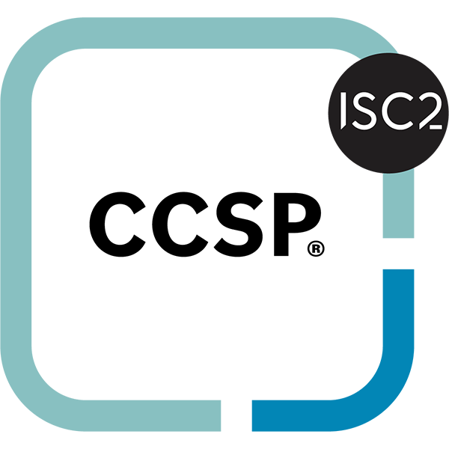
Trochę o sobie
Cloud Security Architect – Azure/M365
Microsoft Certified Trainer since 2007
Microsoft MVP since 2007 – M365 & Security
Twitter - @sagus
LinkedIn - @konradsagala
Github - https://github.com/ksagala
Blog – https://pepugmaster.blogspot.com
Hobby – Podróże, Śpiew, Taniec

Slide 3
Agenda
Understanding DevSecOps and the Need for Security in DevOps
Importance of Security in the DevOps Lifecycle
DevSecOps in Multicloud
DevSecOps Tools
DevSecOps Best Practices
Notes:
We will begin by understanding DevSecOps and its security needs. Then, we will review the importance of security in DevOps lifecycles, followed by an overview of Microsoft Defender for Cloud and its capabilities. Next, we'll explore protecting DevOps tools with Defender for Cloud, and finally, discuss best practices for integrating security within DevSecOps workflows.

Slide 4
Understanding DevSecOps and the Need for Security in DevOps
Notes:
This section defines DevSecOps, differentiates it from traditional DevOps, and highlights the risks and challenges posed by unsecured DevOps environments.

Slide 5
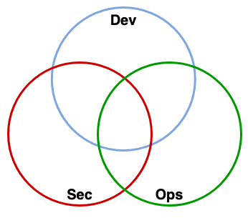
Risks and Challenges in Unsecured DevOps Environments
Vulnerability to Misconfigurations
  DevOps pipelines lacking proper security are prone to misconfigurations that expose the environment to threats.
Supply Chain Attacks
  Unsecured DevOps environments face risks from supply chain attacks compromising software integrity.
Unauthorized Access Risks
  Lack of integrated security leads to unauthorized access, increasing chances of data breaches and compliance failures.
Notes:
Without integrated security, DevOps pipelines are vulnerable to misconfigurations, supply chain attacks, and unauthorized access, leading to potential data breaches and compliance issues.

Slide 6
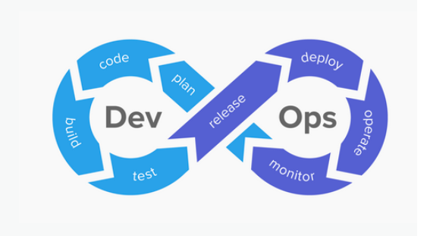
DevOps vs DevSecOps
6
Notes:
.

Slide 7
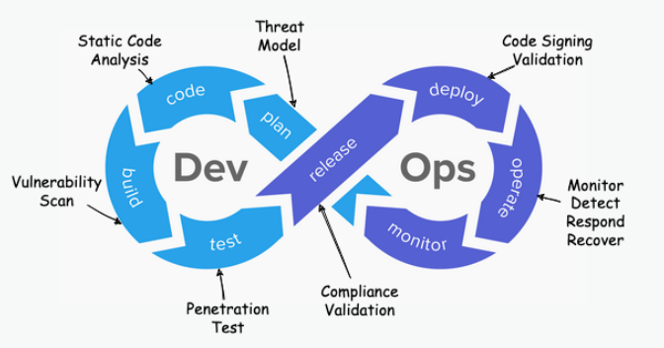
DevOps vs DevSecOps
https://owasp.org/www-project-devsecops-guideline/latest/00a-Overview
7
Notes:
.

Slide 8
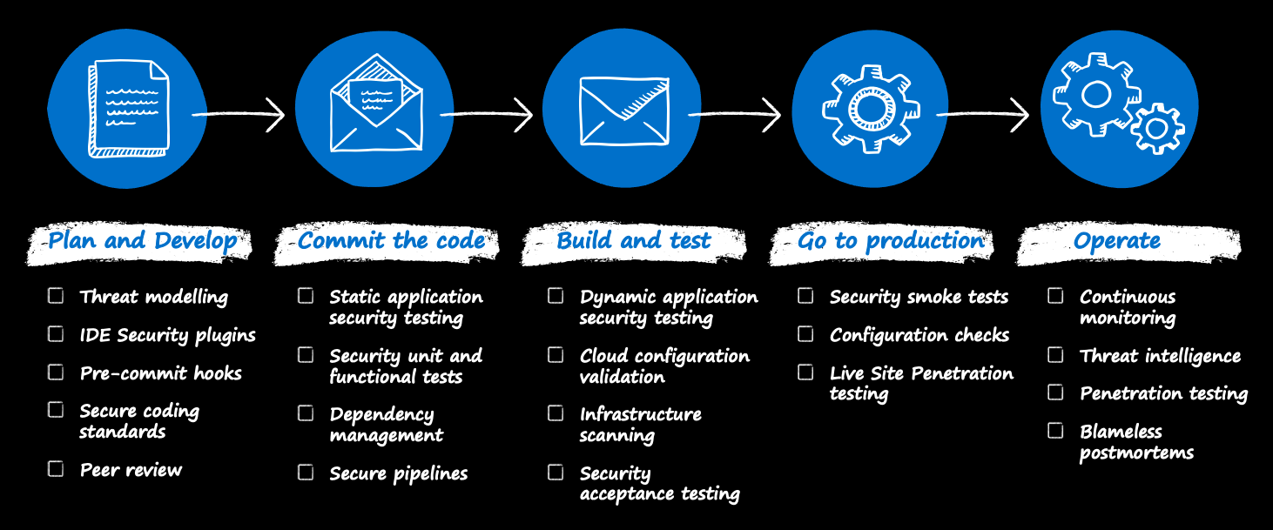
High level DevSecOps process
https://learn.microsoft.com/en-us/azure/well-architected/security/secure-development-lifecycle
8
Notes:
Reference articles on DevSecOps:
https://learn.microsoft.com/en-us/azure/well-architected/security/secure-development-lifecycle
https://www.microsoft.com/en-us/security/business/security-101/what-is-devsecops
https://learn.microsoft.com/en-us/devops/operate/security-in-devops
https://learn.microsoft.com/en-us/security/zero-trust/develop/secure-devops-environments-zero-trust
https://learn.microsoft.com/en-us/security/zero-trust/develop/secure-devops-platform-environment-zero-trust
DevSecOps is the evolution of DevOps where the company takes on a security-first mindset — putting security into every phase of the development lifecycle, from design to delivery.
Plan and develop
Typically, modern development follows an agile development methodology. Scrum is one implementation of agile methodology that has every sprint start with a planning activity. Introducing security into this part of the development process should focus on:
Threat modeling to view the application through the lens of a potential attacker.
IDE security plug-ins and pre-commit hooks for lightweight static analysis checking within an integrated development environment (IDE).
Peer reviews and secure coding standards to identify effective security coding standards, peer review processes, and precommit hooks.
It's not mandatory to add all these steps. But each step helps reveal security issues early when they're much cheaper and easier to fix.
Threat modeling
Threat modeling is arguably the most important security practice. It delivers immediate results and helps establish a security mindset in developers to improve security in all their future projects.
Threat modeling is a simple concept, though it can be detailed and technical if need be. Threat modeling reveals and documents a realistic security view of your application that includes:
How attackers can abuse the application's design.
How to fix vulnerabilities.
How important it is to fix issues.
You can base your approach on methodologies like the STRIDE model, the DREAD model, or OWASP threat modeling.
Commit the code
Typically, developers create, manage, and share their code in repositories such as GitHub or Azure Repos. This approach provides a central, version-controlled library of code for developers to collaborate on easily. However, enabling many collaborators on a single codebase also runs the risk of changes being introduced. That risk can lead to vulnerabilities or unintentionally including credentials or tokens in commits.
To address this risk, development teams should evaluate and implement a repository scanning capability. Repository scanning tools perform static code analysis on source code within repositories. The tools look for vulnerabilities or credential changes and flag any items found for remediation. This capability acts to protect against human error and is a useful safeguard for distributed teams where many people are collaborating in the same repository.
Build and test
Many organizations use build and release pipelines to automate and standardize the processes for building and deploying code. Release pipelines let development teams make iterative changes to sections of code quickly and at scale. The teams won't need to spend large amounts of time redeploying or upgrading existing environments.
Using release pipelines also lets teams promote code from development environments, through testing environments, and ultimately into production. As part of automation, development teams should include security tools that run scripted, automated tests when deploying code into testing environments. The tests should include unit testing on application features to check for vulnerabilities or public endpoints. Testing ensures intentional access.
Go to production and operate
When the solution goes to production, it's vital to continue overseeing and managing the security state. At this stage in the process, it's time to focus on the cloud infrastructure and overall application.

Slide 9
Importance of Security in the DevOps Lifecycle
Notes:
This section addresses the types of threats targeting DevOps pipelines, the implications of security breaches on business and compliance, and the advantages of securing the development process end-to-end.

Slide 10
Threats Targeting DevOps Pipelines and Toolchains
Code Injection Threats
  Code injection attacks introduce malicious code into DevOps pipelines, risking data integrity and system stability.
Compromised Credentials
  Stolen or weak credentials enable unauthorized access, threatening pipeline security and operations.
Vulnerable Third-Party Components
  Using vulnerable third-party components exposes pipelines to security risks and potential exploits.
10
Notes:
---
DevOps pipelines face threats including code injection, compromised credentials, and vulnerable third-party components, all of which can disrupt operations and compromise security.
Image source: Microsoft 365 content library

Slide 11
Benefits of Integrating Security Throughout the Development Process
Early Vulnerability Reduction
  Embedding security early in development minimizes vulnerabilities before they become risks.
Faster Remediation
  Early security enables quicker identification and resolution of security issues.
Compliance Assurance
  Integrating security ensures adherence to regulatory and industry compliance standards.
Resilient Software Delivery
  Security throughout development leads to robust and trustworthy software products.
11
Notes:
---
Embedding security early reduces vulnerabilities, accelerates remediation, and ensures compliance, leading to more resilient and trustworthy software delivery.
Image source: Microsoft 365 content library

Slide 12
MCSB―controls for DevOps security
DS-1: Conduct threat modeling
DS-2: Ensure software supply chain security
DS-3: Secure DevOps infrastructure
DS-4: Integrate static application security testing into DevOps pipeline
DS-5: Integrate dynamic application security testing into DevOps pipeline
DS-6: Enforce security of workload throughout DevOps life cycle
DS-7: Enable logging and monitoring in DevOps
https://learn.microsoft.com/en-us/security/benchmark/azure/mcsb-devops-security
12
Notes:
Microsoft cloud security benchmark outlines seven critical controls for DevOps security.
DS-1 Conduct threat modeling: Perform threat modeling to identify the potential threats and enumerate the mitigating controls.
DS-2 Ensure software supply chain security: Ensure your enterprise’s Software Development Lifecycle (SDLC) or process includes a set of security controls to govern the in-house and third-party software components (including proprietary and open-source software) where your applications have dependencies. Define gating criteria to prevent vulnerable or malicious components being integrated and deployed into the environment.
DS-3 Secure DevOps infrastructure: Ensure the DevOps infrastructure and pipeline follow security best practices across environments including your build, test, and production stages.
DS-4 Integrate static application security testing into DevOps pipeline: Ensure static application security testing (SAST) fuzzy testing, interactive testing, and mobile application testing, are part of the gating controls in the CI/CD workflow. The gating can be set based on the testing results to prevent vulnerable packages from committing into the repository, building into the packages, or deploying into the production.
DS-5 Integrate dynamic application security testing into DevOps pipeline: Ensure dynamic application security testing (DAST) is part of the gating controls in the CI/CD workflow. The gating can be set based on the testing results to prevent vulnerability from building into the packages or deploying into the production.
DS-6 Enforce security of workload throughout DevOps life cycle: Ensure the workload is secured throughout the entire life cycle in development, testing, and deployment stages. Use MCSB to evaluate the controls (such as network security, identity management, privileged access and so on) that can be set as guardrails by default or shift left before the deployment stage. In particular, ensure the following controls are in place in your DevOps process: Automate the deployment by using Azure or third-party tooling in the CI/CD workflow, infrastructure management (infrastructure as code), and testing to reduce human error and attack surface.
DS-7 Enable logging and monitoring in DevOps: Ensure your logging and monitoring scope includes nonproduction environments and CI/CD workflow elements used in DevOps (and any other development processes). The vulnerabilities and threats targeting these environments can introduce significant risks to your production environment if they’re not monitored properly. The events from the CI/CD build, test and deployment workflow should also be monitored to identify any deviations in the CI/CD workflow jobs.

Slide 13
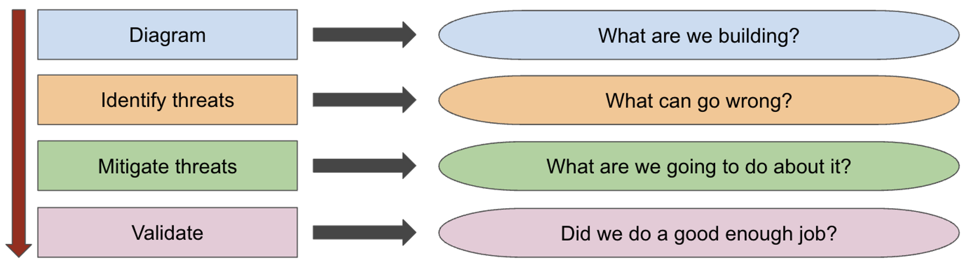
Threat Modeling
https://learn.microsoft.com/en-us/training/paths/tm-threat-modeling-fundamentals/
13

Slide 14
Threat Modeling Frameworks
Framework | Core Focus
STRIDE | General Security
PASTA | Risk-Centric
LINDDUN | Privacy
OCTAVE | Organizational Risk
Trike | System Modeling
VAST | Agile Development
14

Slide 15
Threat Modeling Methodology
STRIDE
STRIDE is a threat modeling methodology developed by Microsoft to help identify security threats across various dimensions. The acronym stands for:
Spoofing,
Tampering,
Repudiation,
Information Disclosure,
Denial of Service,
Elevation of Privilege.
Each category represents a type of threat that could be posed to a system. By analyzing each component of a system against these six threat types, security teams can systematically identify vulnerabilities and potential attacks.
STRIDE is particularly useful in the early stages of software development, as it allows teams to anticipate and mitigate risks before they become critical. The process involves identifying system entities, defining data flows, and then mapping potential threats to these flows.
15

Slide 16
Threat Modeling Methodology - STRIDE
S - Spoofing Identity
Description: An attacker pretends to be someone or something they are not in order to gain unauthorized access to systems or data.
Example: Using a stolen username and password to log in to a system.
Security Property required: Authentication
2. T - Tampering with Data/System Configurations
Description: Unauthorized modification of data, either at rest or in transit, to alter its meaning or functionality.
Example: Altering the content of a file or a database record to inject malicious code or modify transaction details.
Security Property required: Integrity
3. R - Repudiation
Description: Actions that can be performed in such a way that the actor can deny having performed them. This usually happens when there are insufficient mechanisms in place to prove the occurrence of an action.
Example: A user denying that they made a purchase or performed a transaction because there are no logs or evidence to prove otherwise.
Security Property required: Non-repudiation
16

Slide 17
Threat Modeling Methodology - Stride
4. I - Information Disclosure
Description: Unauthorized access to or exposure of sensitive information.
Example: An attacker gains access to personal identifiable information (PII) stored in a database due to improper access controls or lack of encryption.
Security Property required: Confidentiality
5. D - Denial of Service (DoS)
Description: Attacks aimed at making a system or service unavailable to its intended users.
Example: Flooding a website with traffic to overwhelm the server and make it unavailable to legitimate users.
Security Property required: Availability
6. E - Elevation of Privilege
Description: A user or attacker gains higher-level permissions than they are authorized to have, allowing them to perform restricted actions.
Example: Exploiting a vulnerability in the system to gain administrative access and perform privileged operations.
Security Property required: Authorization
17

Slide 18
Threat Modeling Methodology for AI challenges
STRIDE: Strengths and Weaknesses for Agentic AI
Strengths: STRIDE provides a solid foundation for identifying common security vulnerabilities relevant to AI agents, such as data tampering or denial-of-service attacks. It's relatively easy to understand and apply, making it a good starting point for many projects.
Weaknesses: While STRIDE is a good starting point, it doesn't address the unique challenges of AI agents, such as adversarial attacks, or risks due to their unpredictable learning and decision-making processes.
Specific AI Gaps: STRIDE lacks the necessary scope to address threats unique to AI, such as adversarial machine learning, data poisoning, and struggles to model the dynamic, autonomous behaviors of AI agents. It does not explicitly consider the impact of multiple AI agents interacting within an ecosystem.
Applicability: STRIDE can be used as a starting point, but it needs significant augmentation to be effective for Agentic AI, requiring added AI-specific categories or adapting existing ones to reflect new risks.
https://cloudsecurityalliance.org/blog/2025/02/06/agentic-ai-threat-modeling-framework-maestro
18

Slide 19
Threat Modeling Methodology for AI
To fill these gaps, CSA introduced MAESTRO (Multi-Agent Environment, Security, Threat Risk, and Outcome), a framework built for Agentic AI.
MAESTRO’s Principles
Extended Security Categories: We're expanding traditional categories like STRIDE, PASTA, and LINDDUN with AI-specific considerations. For example:
Multi-Agent and Environment Focus: Explicitly considering the interactions between agents and their environment. A self-driving car must be aware of other cars, objects, and weather conditions.
Layered Security: Security isn't a single layer, but a property that must be built into each layer of the agentic architecture.
AI-Specific Threats: Addressing threats arising from AI, especially adversarial ML and autonomy-related risks.
Risk-Based Approach: Prioritizing threats based on likelihood and impact within the agent's context.
Continuous Monitoring and Adaptation: Ongoing monitoring, threat intelligence, and model updates to address the evolving nature of AI and threats.
https://cloudsecurityalliance.org/blog/2025/02/06/agentic-ai-threat-modeling-framework-maestro
19

Slide 20
Threat Modeling Methodology for AI
To fill these gaps, CSA introduced MAESTRO (Multi-Agent Environment, Security, Threat Risk, and Outcome), a framework built for Agentic AI.
MAESTRO’s Principles
Extended Security Categories: We're expanding traditional categories like STRIDE, PASTA, and LINDDUN with AI-specific considerations. For example:
Multi-Agent and Environment Focus: Explicitly considering the interactions between agents and their environment. A self-driving car must be aware of other cars, objects, and weather conditions.
Layered Security: Security isn't a single layer, but a property that must be built into each layer of the agentic architecture.
AI-Specific Threats: Addressing threats arising from AI, especially adversarial ML and autonomy-related risks.
Risk-Based Approach: Prioritizing threats based on likelihood and impact within the agent's context.
Continuous Monitoring and Adaptation: Ongoing monitoring, threat intelligence, and model updates to address the evolving nature of AI and threats.
https://github.com/CloudSecurityAlliance/MAESTRO
https://cloudsecurityalliance.org/blog/2025/02/06/agentic-ai-threat-modeling-framework-maestro
20

Slide 21
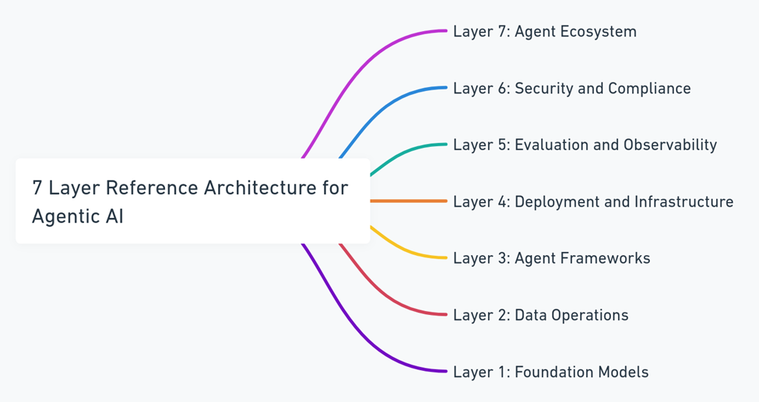
Threat Modeling Methodology for AI
https://cloudsecurityalliance.org/blog/2025/02/06/agentic-ai-threat-modeling-framework-maestro
21

Slide 22
Multicloud DevOps

Slide 23
Multicloud DevOps platforms
GitHub
  The Community Hub. Owned by Microsoft, it is the home of open source and has the largest developer network in the world. Best for Open-source projects, startups, and teams prioritizing developer recruitment/familiarity.
GitLab
  The All-in-One. A single application for the entire DevSecOps lifecycle (planning, SCM, CI/CD, security). Best for Enterprises needing strict governance, self-hosting, and built-in security scanning.
Azure DevOps
  The Enterprise Workhorse. Deeply integrated with the Azure cloud and the Microsoft 365 ecosystem. Large corporations already using Azure/Active Directory and needing robust project management (Boards).
Bitbucket
  The Atlassian Native. Seamlessly connects with Jira and Confluence. It is part of the Atlassian "Inner Loop.". Best for business teams already living in Jira who want tight "issue-to-code" traceability.
23

Slide 24
Multicloud DevOps platforms
Platform | Primary "Flavor" | Best For...
GitHub | The Community Hub. Owned by Microsoft, it is the home of open source and has the largest developer network in the world. | Open-source projects, startups, and teams prioritizing developer recruitment/familiarity.
GitLab | The All-in-One. A single application for the entire DevSecOps lifecycle (planning, SCM, CI/CD, security). | Enterprises needing strict governance, self-hosting, and built-in security scanning.
Azure DevOps | The Enterprise Workhorse. Deeply integrated with the Azure cloud and the Microsoft 365 ecosystem. | Large corporations already using Azure/Active Directory and needing robust project management (Boards).
Bitbucket | The Atlassian Native. Seamlessly connects with Jira and Confluence. It is part of the Atlassian "Inner Loop." | Business teams already living in Jira who want tight "issue-to-code" traceability.
24

Slide 25
Multicloud DevOps platforms
Market share in version control is difficult to measure because it's split between Public/SaaS (where GitHub dominates) and On-Premise/Self-Hosted (where GitLab and Bitbucket are much stronger).
According to recent 2025–2026 market intelligence reports:
GitHub: Holds roughly 31% to 45% of the global version control market. It is the undisputed leader in "developer mindshare," hosting over 100 million developers.
GitLab: Commands approximately 18% to 22% market share. It is the leader in the self-hosted segment, often preferred by regulated industries (Finance/Healthcare) for data residency.
Bitbucket: Occupies about 10% to 15% of the market. Its user base is concentrated within the Atlassian ecosystem, favored by mid-market companies.
Azure DevOps: While specific "market share" percentages are lower for its repository service specifically, it is a dominant force in the broader DevOps Platform category, especially among Fortune 500 companies.
25

Slide 26
DevOps platforms - alternatives
Platform | Core Strength | Security Focus
Harness | AI-Powered Guardrails | Automated Vulnerability Correlation
AWS CodeSuite | Deep AWS Integration | Hardware-level Encryption (KMS)
CircleCI | Pipeline Speed | Fast, Ephemeral Build Environments
Codefresh | GitOps / Kubernetes | No-Credential Production Access
JFrog | Binary Management | Comprehensive Software Bill of Materials (SBOM)
26

Slide 27
DevSecOps native protection
Platform | SCA (Dependencies) | SAST (Static Code) | DAST (Runtime/Web) | Secret Scanning
GitHub | Dependabot | CodeQL | No (Requires 3rd party) | Push Protection
GitLab | Dependency Scanning | Advanced SAST | GitLab DAST | Secret Detection
Azure DevOps | Advanced Security | CodeQL (via GHAS) | No (Requires 3rd party) | Secret Scanning
Bitbucket | Bitbucket Security | Code Insights | No (Requires 3rd party) | Secret Scanning
GHAS – GitHub Advanced Security
27
Notes:
GitHub (Advanced Security - GHAS)
GitHub's security is built on CodeQL, which treats code like data that can be queried.
SAST: CodeQL is industry-leading. It doesn't just look for patterns; it follows "data flow" to see if a user-controlled input actually reaches a dangerous sink (like a database query).
SCA: Dependabot is the gold standard. It doesn't just alert you; it creates the Pull Request to fix the vulnerability automatically.
DAST: None. GitHub expects you to use a GitHub Action (like StackHawk or OWASP ZAP) to handle dynamic testing.
GitLab (Ultimate Tier)
GitLab is the only platform that provides a "native" DAST engine built directly into the runner.
SAST: Uses GitLab Advanced SAST (proprietary) and Semgrep. In 2026, it includes AI-powered False Positive Detection to filter out noise.
SCA: Integrated directly into the Merge Request. You can see if a new library is vulnerable before you even merge the code.
DAST: Built-in. It can perform Passive scans (looking at headers) and Active scans (simulating attacks like SQLi) against a "Review App" (an ephemeral version of your site created during the build).
Azure DevOps (GitHub Advanced Security for ADO)
Microsoft has ported the GitHub security engine over to Azure DevOps.
SAST & SCA: It uses the exact same CodeQL and Dependency Scanning engines as GitHub. The results are surfaced natively within the Azure DevOps "Security" tab.
DAST: None. You must integrate with Microsoft Defender for Cloud or a third-party pipeline task.
Unique Feature: Tightest integration with Microsoft Defender for Cloud, allowing a single "Security Score" that spans from your code to your Azure production environment.
Bitbucket (Atlassian Ecosystem)
Bitbucket has the least "native" logic and relies on its Security Tab acting as an aggregator for partners.
SAST & SCA: In 2026, Bitbucket uses Bitbucket Security Analysis (powered largely by Snyk technology) to provide basic scanning for free.
DAST: None. Completely dependent on integrations with tools like Invicti or StackHawk.
Strength: If you use Jira, security vulnerabilities in Bitbucket can automatically create and track Jira tickets for the development team.

Slide 28
Best Practices for DevSecOps
Notes:
This section covers continuous security assessment, role-based access control, secrets management, and fostering collaboration and training among teams for effective DevSecOps.

Slide 29
Challenges and How to Overcome Them
Adopting DevSecOps isn’t without hurdles.
Common challenges include:
Resistance to Change: Developers may resist additional security steps. Address this through training and by demonstrating the value of early vulnerability detection.
Tool Overload: Too many tools can overwhelm teams. Prioritize tools that integrate seamlessly with existing workflows.
Skill Gaps: Not all developers are security experts. Invest in ongoing training and pair developers with security champions.
29

Slide 30

Implementing Continuous Security Assessment
Regular Security Assessments
  Conducting regular security assessments ensures early detection of potential vulnerabilities in the development lifecycle.
Automated Vulnerability Detection
  Automation enables continuous vulnerability scanning, reducing manual effort and increasing assessment frequency.
Integrating Security in Development
  Embedding security assessment throughout development maintains protection and reduces risk of breaches.
30
Notes:
---
Regular and automated security assessments help identify and remediate vulnerabilities promptly, ensuring security remains integral throughout development.
Image source: Microsoft 365 content library

Slide 31
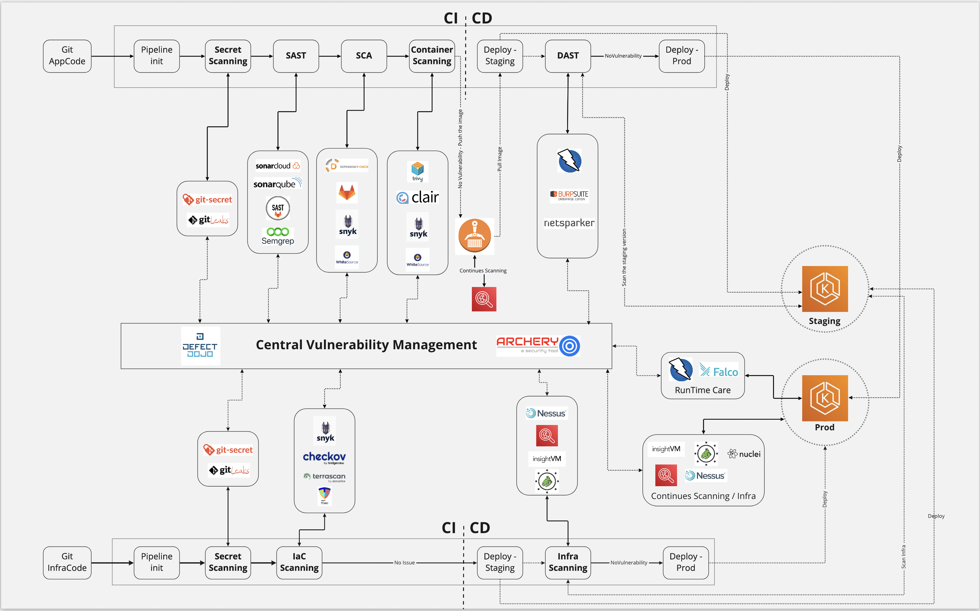
https://owasp.org/www-project-devsecops-guideline/latest/index
31

Slide 32
Role-Based Access Control and Secrets Management
Precise Access Rights
  Role-based access control ensures users have only necessary permissions, reducing risks of unauthorized access.
Secrets Management
  Securely managing secrets like passwords and keys prevents data leaks and strengthens security in DevOps.
32
Notes:
---
Defining precise access rights and securely managing secrets reduces the risk of unauthorized access and data leaks within DevOps environments.
Image source: Microsoft 365 content library

Slide 33

Ongoing Training and Collaboration Between Development, Security, and Operations Teams
Shared Responsibility Culture
  Encouraging a culture of shared responsibility enhances security by involving all teams in proactive measures.
Continuous Training
  Regular training sessions improve security awareness and keep teams updated on best practices.
Effective Communication
  Open communication channels between development, security, and operations improve coordination and response times.
33
Notes:
---
Promoting a culture of shared responsibility through training and communication improves security awareness and effectiveness across all teams involved.
Image source: Microsoft 365 content library

Slide 34
Conclusion
Security Integration
Defender for Cloud embeds security directly into DevOps workflows to ensure continuous protection.
Risk Mitigation
It helps mitigate risks by identifying vulnerabilities early in the software delivery process.
Compliance and Efficiency
Enables compliant and efficient software delivery in modern DevSecOps environments.
Notes:
Defender for Cloud provides powerful tools to embed security seamlessly into DevOps workflows, mitigating risks and enabling secure, compliant, and efficient software delivery in modern DevSecOps environments.

Slide 35
Dziękuję.
Pytania?

